Slide 1
AIR TICKET RESERVATION SYSTEM
PRESENTED BY
KEERTHANA R (15CSR083)
SUNMATHI P (15CSR215)
VISHALINI V (15CSR238)
GUIDED BY
K.DINESH

Slide 2
PROJECT OVERVIEW
The main objective of this system is to design and develop an Air Ticket Reservation System
Mainly intended for customers who need to check their invoices and cancel their tickets
This system will be implemented using Java Servlet technology and Tomcat Server along with MySQL for database

Slide 3
OBJECTIVES
The Main purpose of E-Air Ticket Reservation is to make online the process of the air ticket reservation and cancelation system.
To create a distributed system that will be used by customers
To ensure that ticket reservation is easy and user friendly for customers
Reduce the work load of ticket officers
Provide a large number of ticket reservation and cancellation service in a few time

Slide 4
Scope of the system
The E-Air Ticket Reservation application is used by the Admin and User to perform the following functions:
LEVEL 0 USER- Administrator
Can do Customer Registration
Searching and Booking of flight ticket.
LEVEL 1 USER – User
Can edit the customer profile and cancel the flight ticket.
User can see the booking invoice.

Slide 5
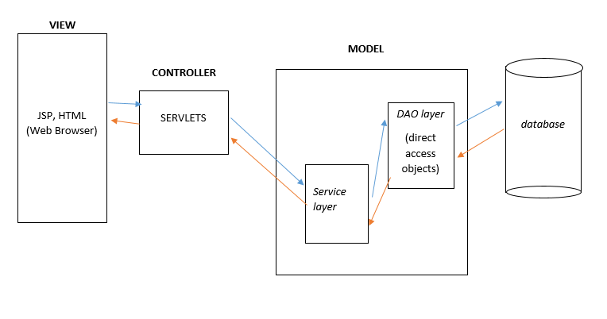
MVC ARCHITECTURE

Slide 6
MODULES
Login Module
Customer Registration Module
Search flight Module
Booking Module
View Booking Invoices Module
Cancel Ticket Module

Slide 7
FUNCTIONAL REQUIREMENTS
Authentication for users
Displaying customers booking invoices
Registering new customer
Editing profile facility for existing customer
Searching flight depending upon their need
Booking seats based on availability
Displaying refundable amount in case of ticket cancellation

Slide 8
Non functional Requirements
UI Requirements
The front end should be user-friendly and pleasant
All entered values should be validated
Installation, Deployment & Operational Requirements
Needs Apache Tomcat server for deployment with MySQL 5.5 database for persistence
Should run on Windows or Linux platform.

Slide 9
Software System Requirements
an independent system ,implemented using J2EE technologies.
When a user connects to the Web Server, the Web Server will interact with the Database after processing the business logic to transfer data to and from a database.
Apache Tomcat 7.0 Web Server.
MySQL database for data storage

Slide 10
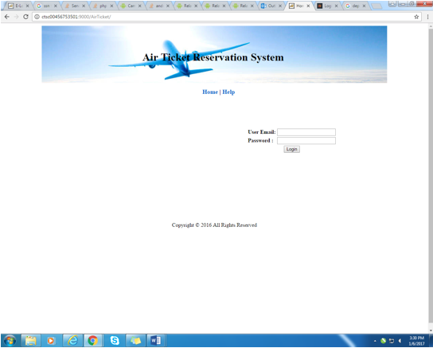
SCREENSHOTS
LOGIN

Slide 11
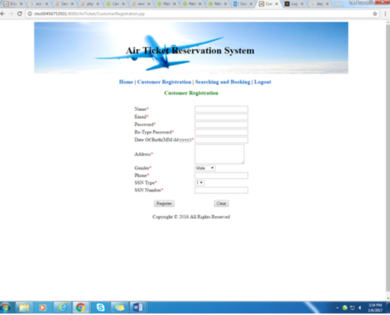

Slide 12
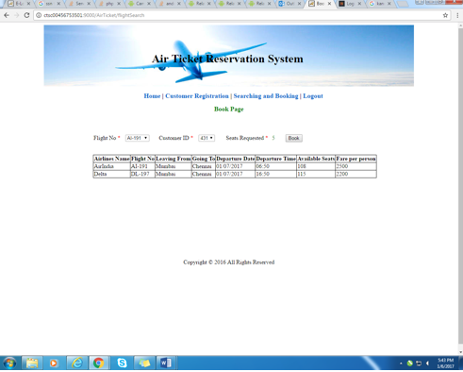

BOOKING PAGE
BOOKING INVOICE

Slide 13
THANK YOU

